Slide 1
Professor
Jorge Alfonso Meléndez Acuña

Slide 2
Welcome
It's important to ask:
How robust is a network?
Depending on its topology, how easy is it to attack? How vulnerable are networks?

Slide 3
Schedule
Network Science for Data Analytics
Unit 1
Introduction to Network Analysis
Unit 2
Centrality
Measures
Unit 3
Introduction to Network Models
Unit 4
Community Detection
Unit 5
Error and Attack Tolerance
Unit 6
Graph Machine Learning
Introduction to
Data Science
Basic Concepts of Graph Theory
Hubs
Communities
Vulnerability in networks
Machine Learning with Graphs
Introduction to Network Science
Small Worlds
Network Models
Deep Learning with Graphs

Slide 4
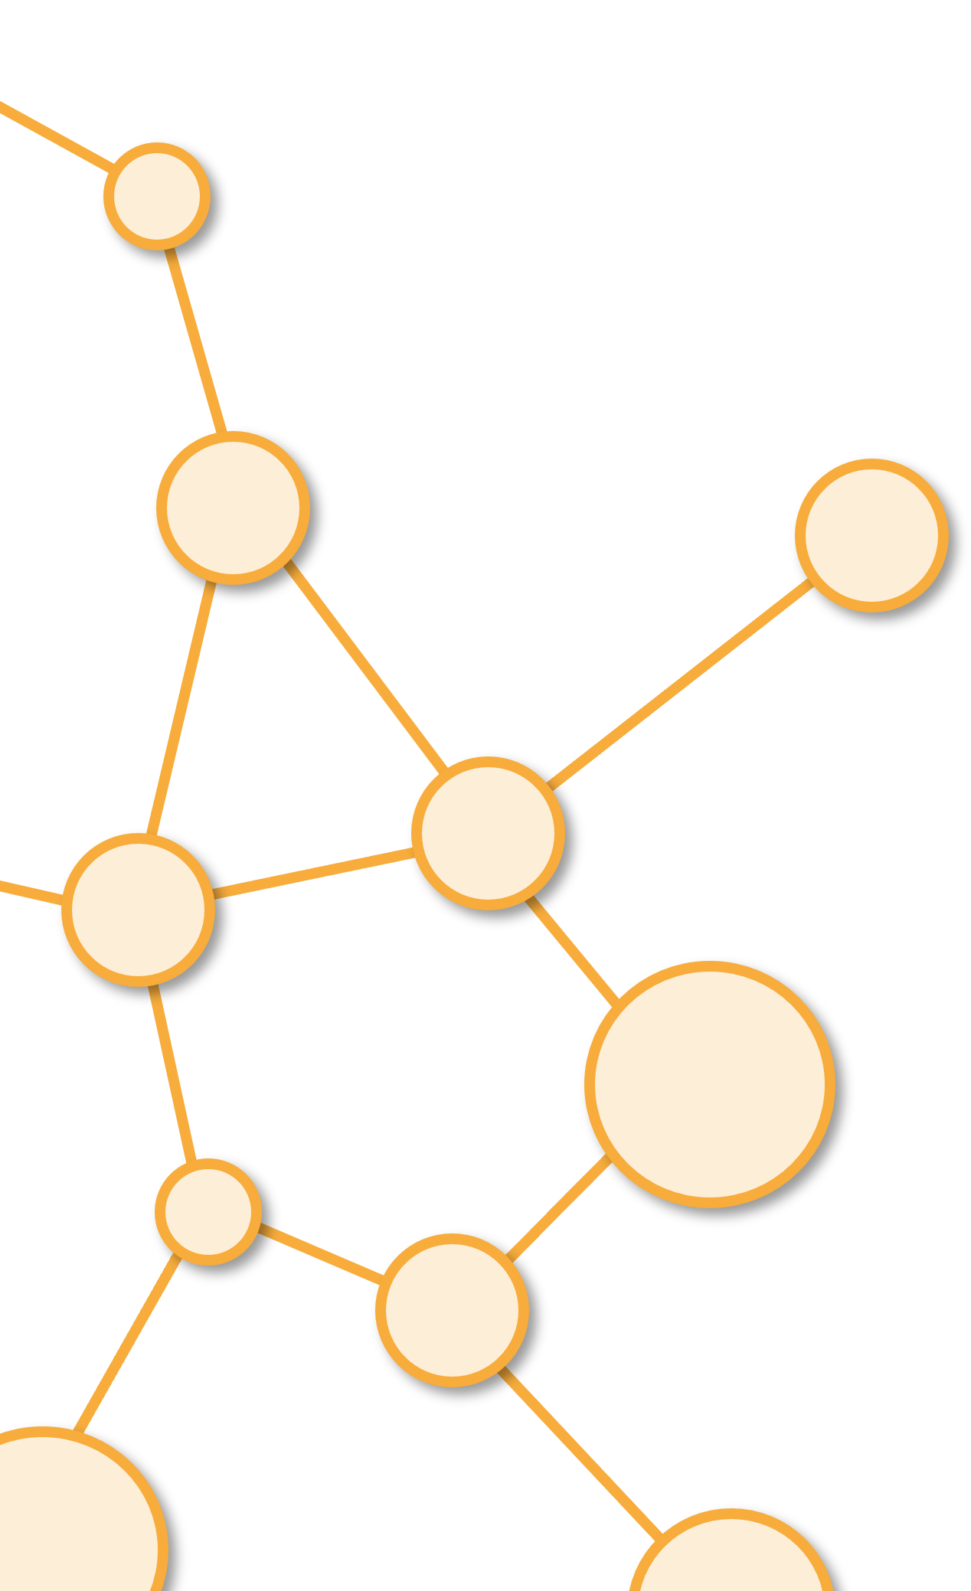
Error and Attack Tolerance
Unit 5

Slide 5
Outline
2. Simple and Complex Contagion

Slide 6
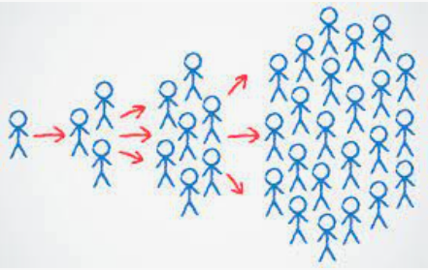
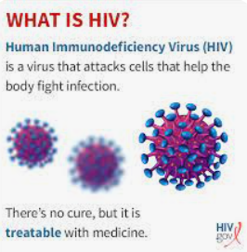
Biological vs.Social Contagion
Why do some social contagions seem to spread easily while others struggle to get going?
For instance, why has HIV spread so rapidly through the World’s population, but behaviors that can prevent HIV have not?
The challenge with solving this kind of problem is that the spread of disease has become the default way of thinking about most kinds of social diffusion
Reference:

Slide 7
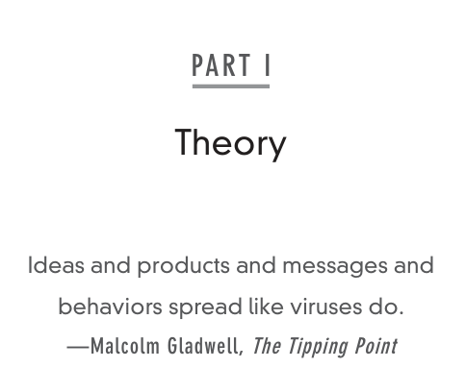

Remember...
The spread of information, cultural norms and social behavior can be conceptually modeled as a contagion process.
Is this Really true?
Year : 2000
Reference:

Slide 8
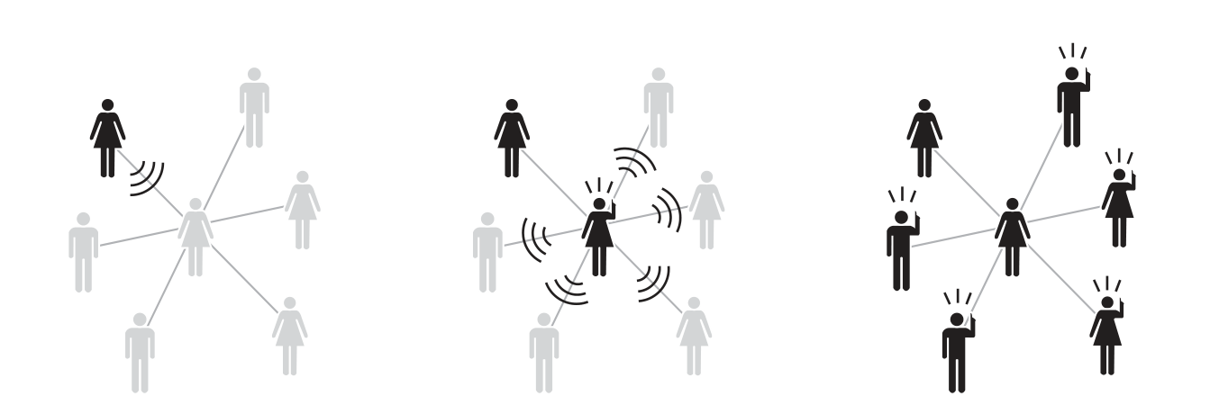
Remember...
Information is typically thought to spread in a similar fashion: one person can costlessly repeat some news or a story to many others, who can each in turn propagate it through a population.
Is this how social diffusion works?
Reference:

Slide 9

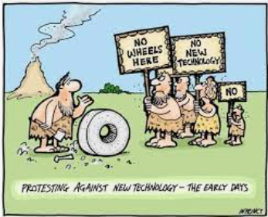

What is the difference?
Why then do so many social movements take months or years to spread?
Why do so many new technologies struggle to take off?
And, why do disease prevention strategies often fail to take hold?
Reference:

Slide 10
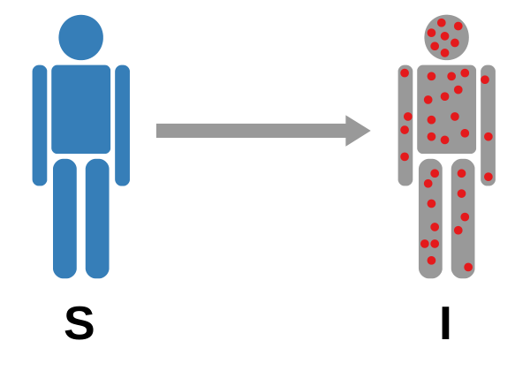
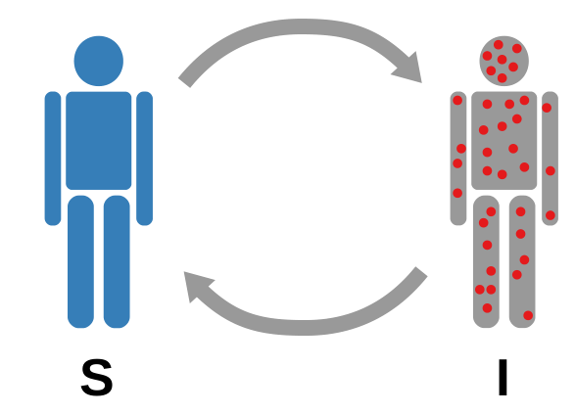
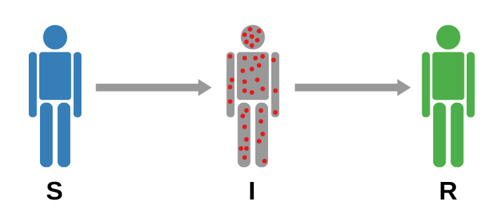
Homogenous Assumption
SI, SIS, and SIR models are useful and generated tons of great insights.
They shared an assumption:
Every time a susceptible individual comes in contact with an infected individual, they have a chance to become infected as well. If that does not happen, a healthy person is still in the susceptible pool.
“Infinite” chances to get infected
Reference:

Slide 11
One Example of Complex Contagion
What if each node gets only one chance to be infected
Typical Examples:
Attending a training session
Filling a research survey
A Marketing Campaign, not everyone buys the product
Reference:

Slide 12
Complex Contagion
There are fundamentally two ways to make diffusion models more complex and realistic. They involve changing two things:
1. the assumption that each individual gets infinite chances to infect their neighbors
2. The triggering mechanism, which is the condition regulating the S → I transition (reinforcement)
Reference:

Slide 13
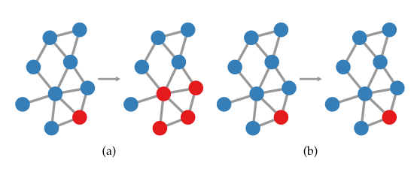
Triggering Mechanism
The main difference between simple and complex contagion is that, in the latter, you require reinforcement.
If we require a node to enter into contact with two infected individuals rather than one, the figure shows that the outbreak from a single seed is impossible.
(a) Simple (b) Complex
Reference:

Slide 14
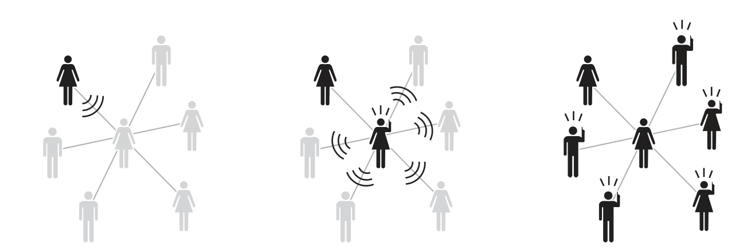
Simple Contagion
Reference:

Slide 15
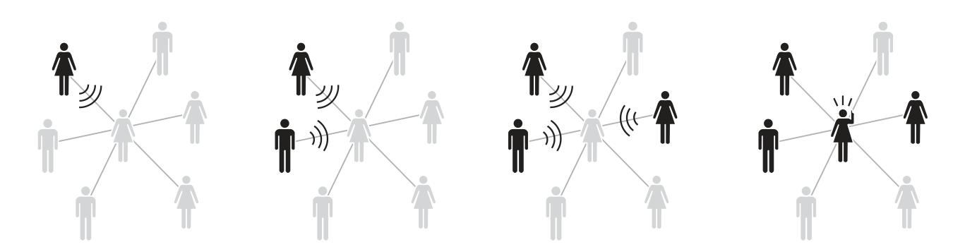
Complex Contagion
Reinforcement = 3
Reference:

Slide 16
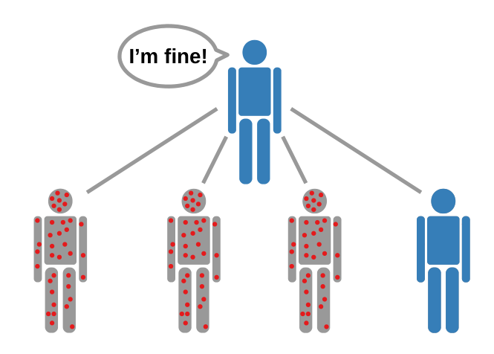

Absolute vs. Relative Triggering
To be infected, you need a threshold of
Infected neighbors:
This value can be fixed (2 or 3 ) (Absolute)
Or the threshold can depend of the number of neighbors:
50% or 40% of neighbors infected ( Relative)
Threshold = 3
Link to Simple-Complex Contagion Model
Reference:

Slide 17
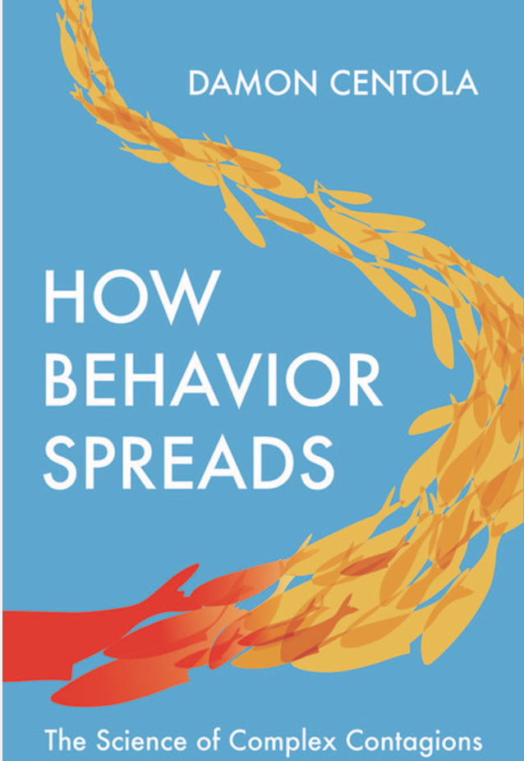

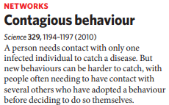
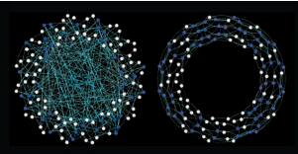
Pioneer of Contagious Behaviour
Damon Centola
Professor of Communication, Sociology and Engineering
Director of the Network Dynamics Group
University of Pennsylvania
Small World Centola
Reference:

Slide 18
Simple vs. Complex Contagion
Activity Nicky case
30 Min
https://ncase.me/crowds/

Slide 19
Simple vs. Complex Contagion
Activity Nicky case
30 Min
https://ncase.me/crowds/

Slide 20
Simple vs. Complex Contagion
Slides Activity

Slide 21
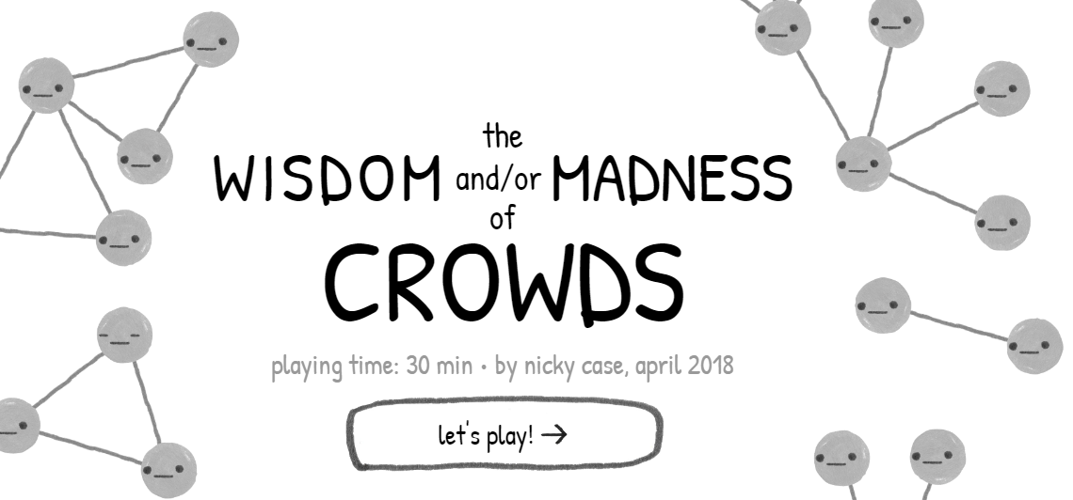
The Wisdom and Madness of Crowds
Reference: https://ncase.me/crowds/

Slide 22
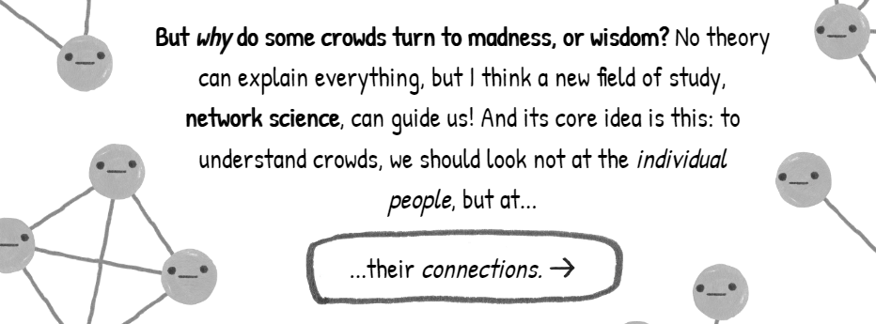
Why Network Science?
Reference: https://ncase.me/crowds/

Slide 23
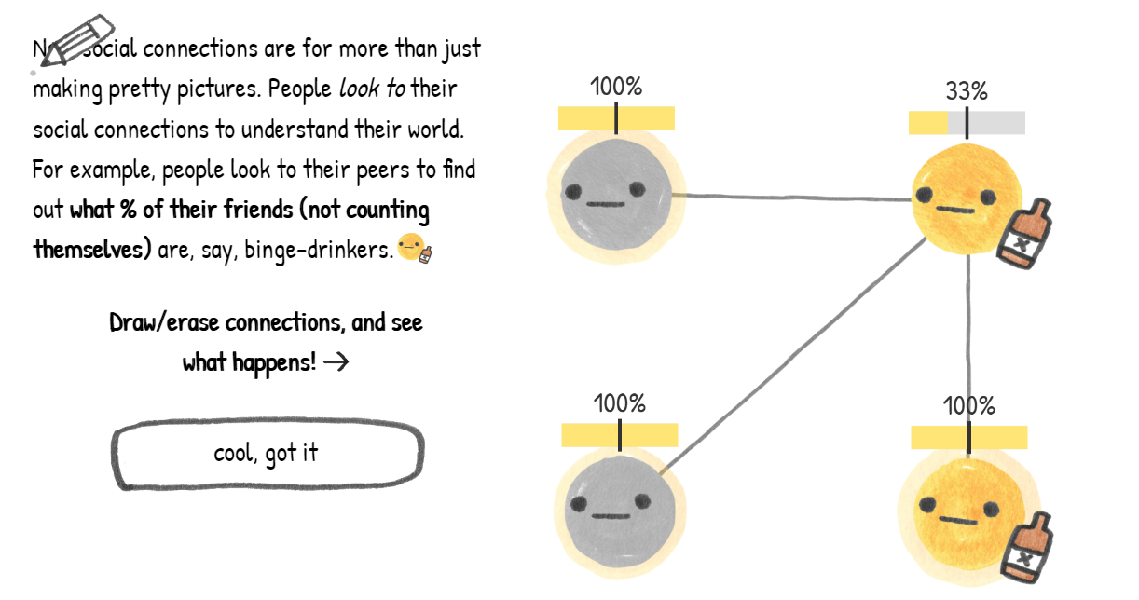
Percentage of beer neighbors
Reference: https://ncase.me/crowds/

Slide 24
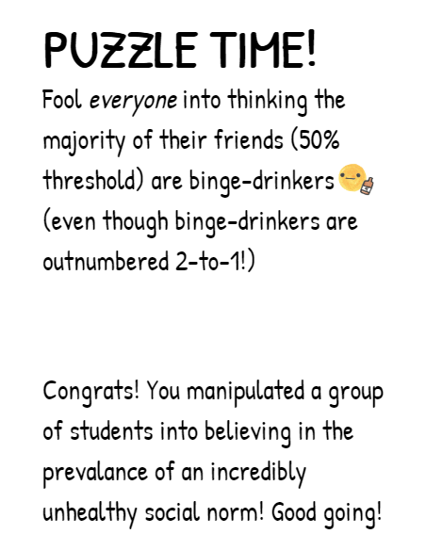
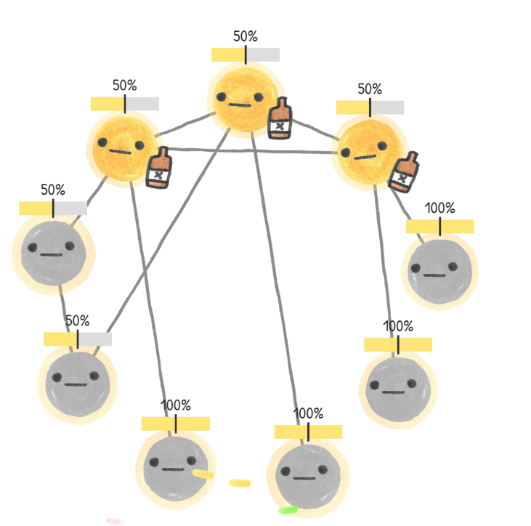
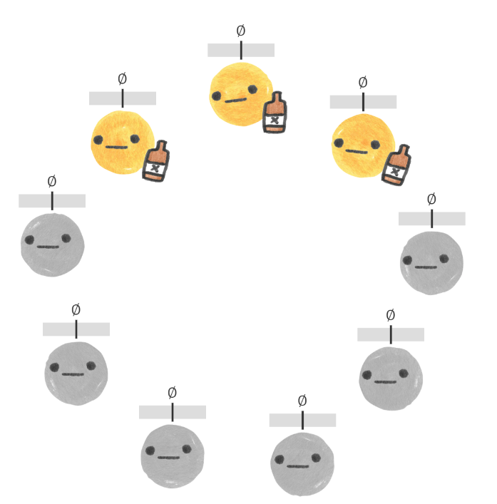
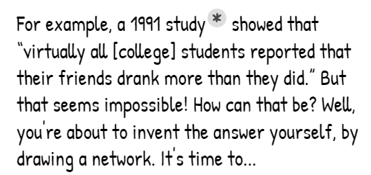
Friendship paradox
10 Connections
With less Connections?
Reference: https://ncase.me/crowds/

Slide 25
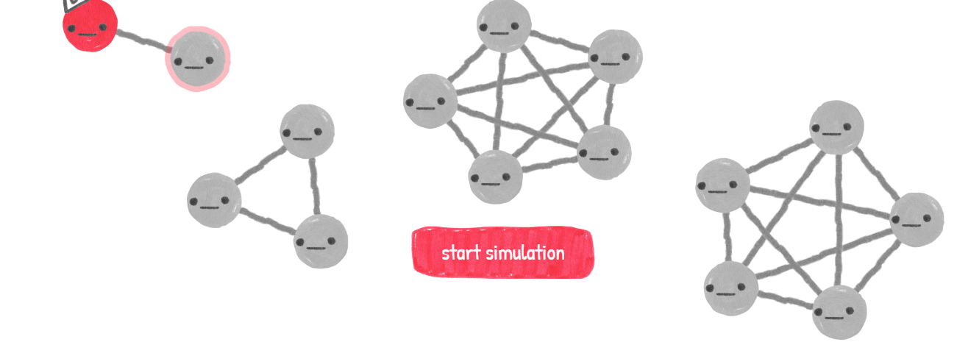
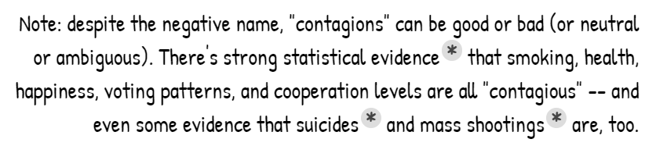
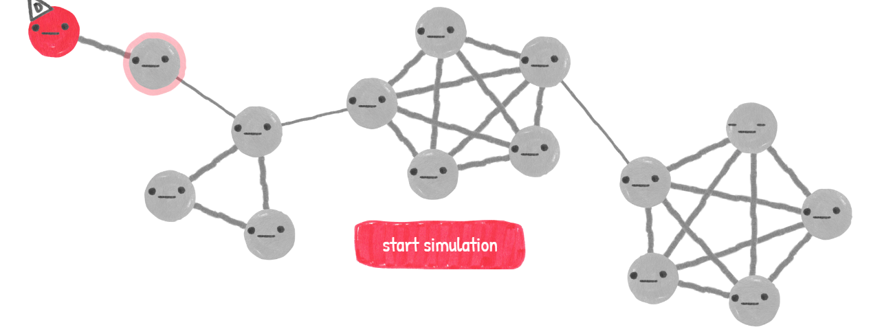
Simple Contagions
Reference: https://ncase.me/crowds/

Slide 26
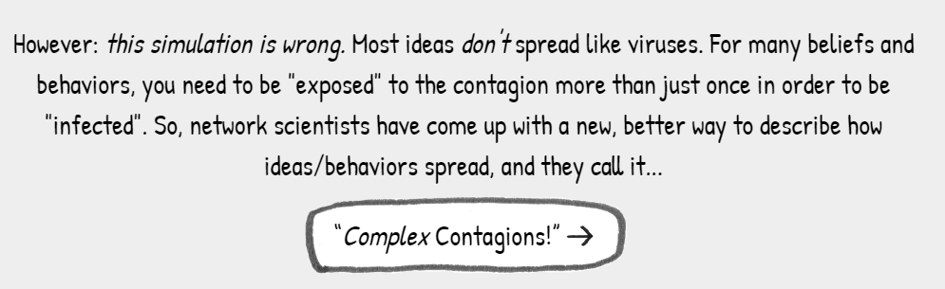
Complex Contagions
Reference: https://ncase.me/crowds/

Slide 27
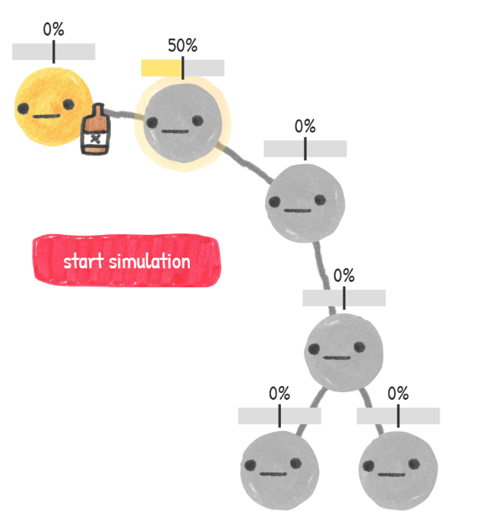
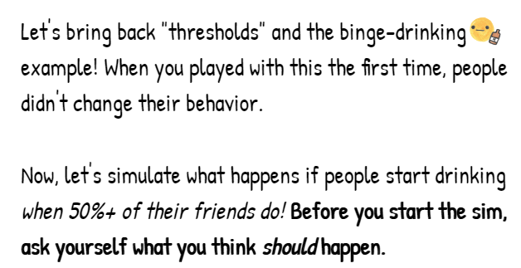

Slide 28
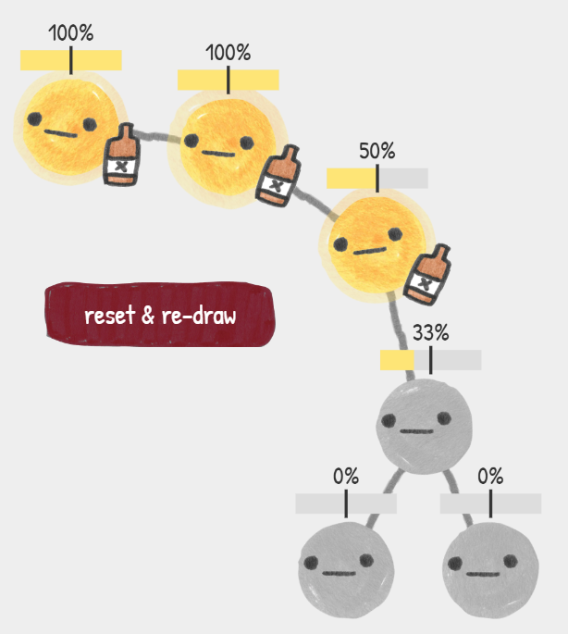
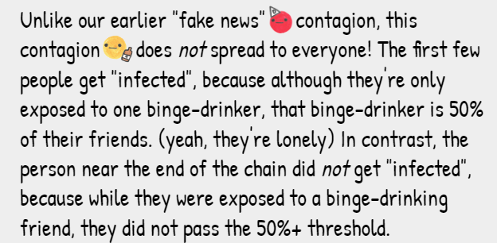
Not Everyone Contagious!!!!!
Reference: https://ncase.me/crowds/

Slide 29
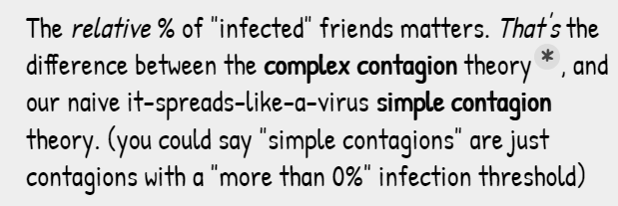
Simple vs. Complex Contagion
Reference: https://ncase.me/crowds/

Slide 30
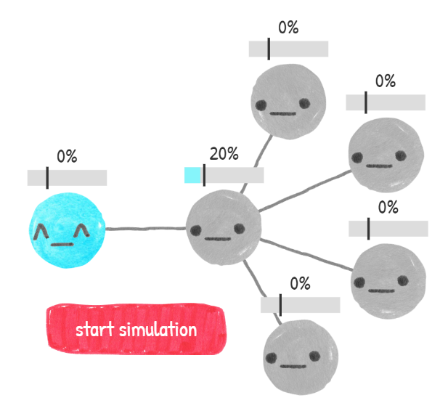
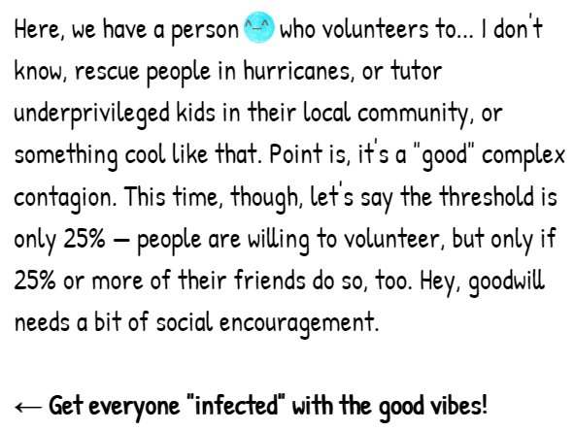
Crowd Wisdom
Reference: https://ncase.me/crowds/

Slide 31
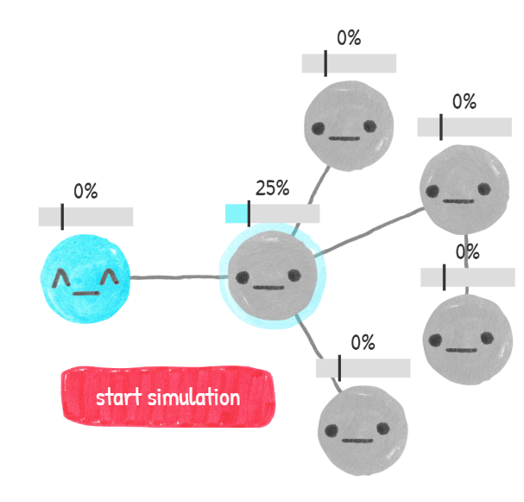
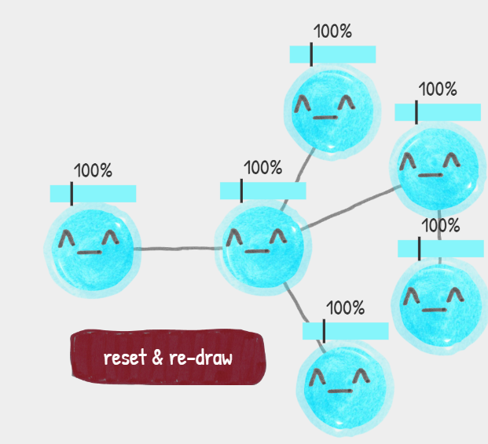
One Solution
Reference: https://ncase.me/crowds/

Slide 32

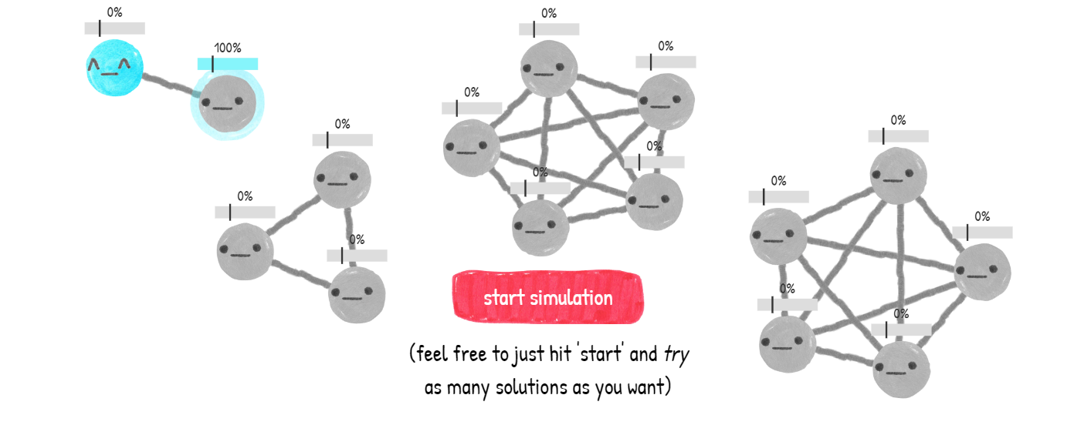
Power and Weirdness of Complex Contagions
Reference: https://ncase.me/crowds/

Slide 33
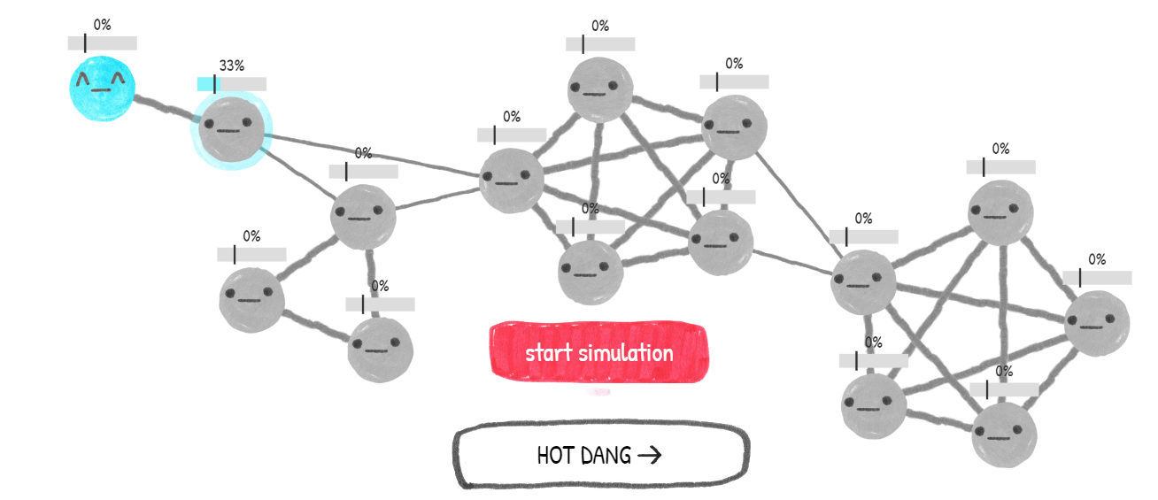
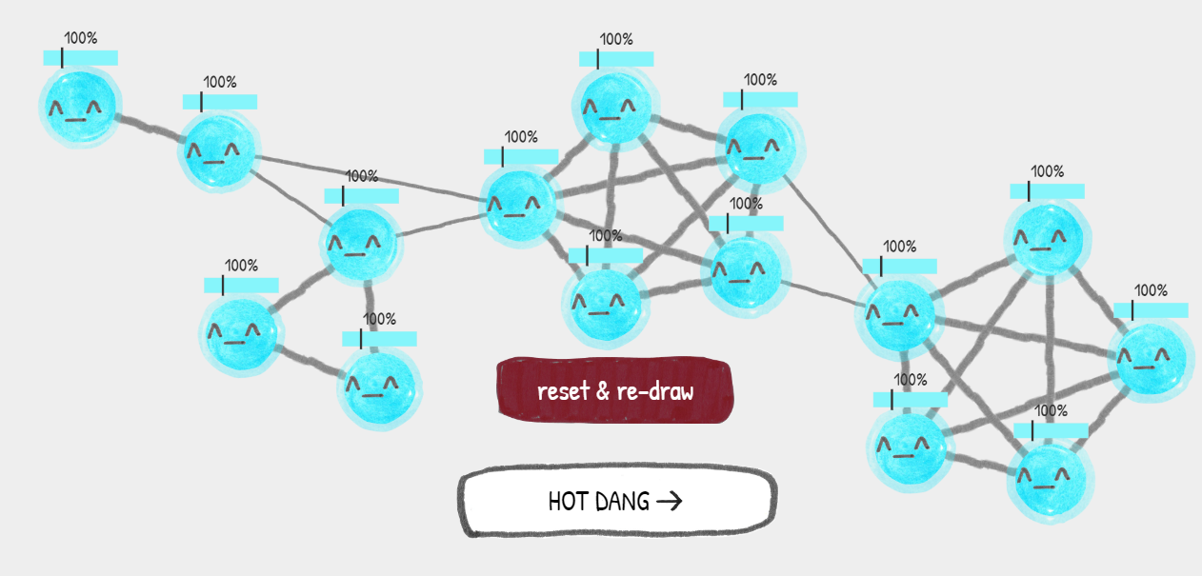
One Solution
Reference: https://ncase.me/crowds/

Slide 34
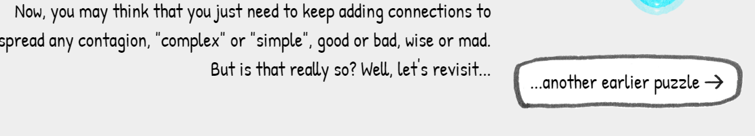
Always Adding to Spread Contagion?
Reference: https://ncase.me/crowds/

Slide 35
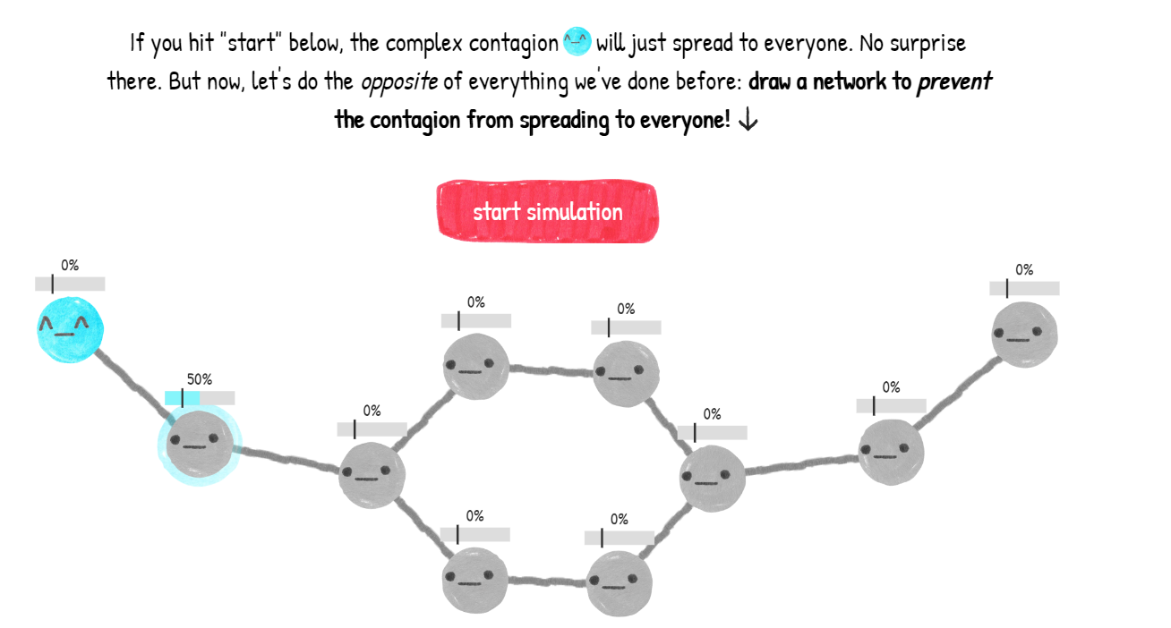
Preventing a Contagion
Reference: https://ncase.me/crowds/

Slide 36
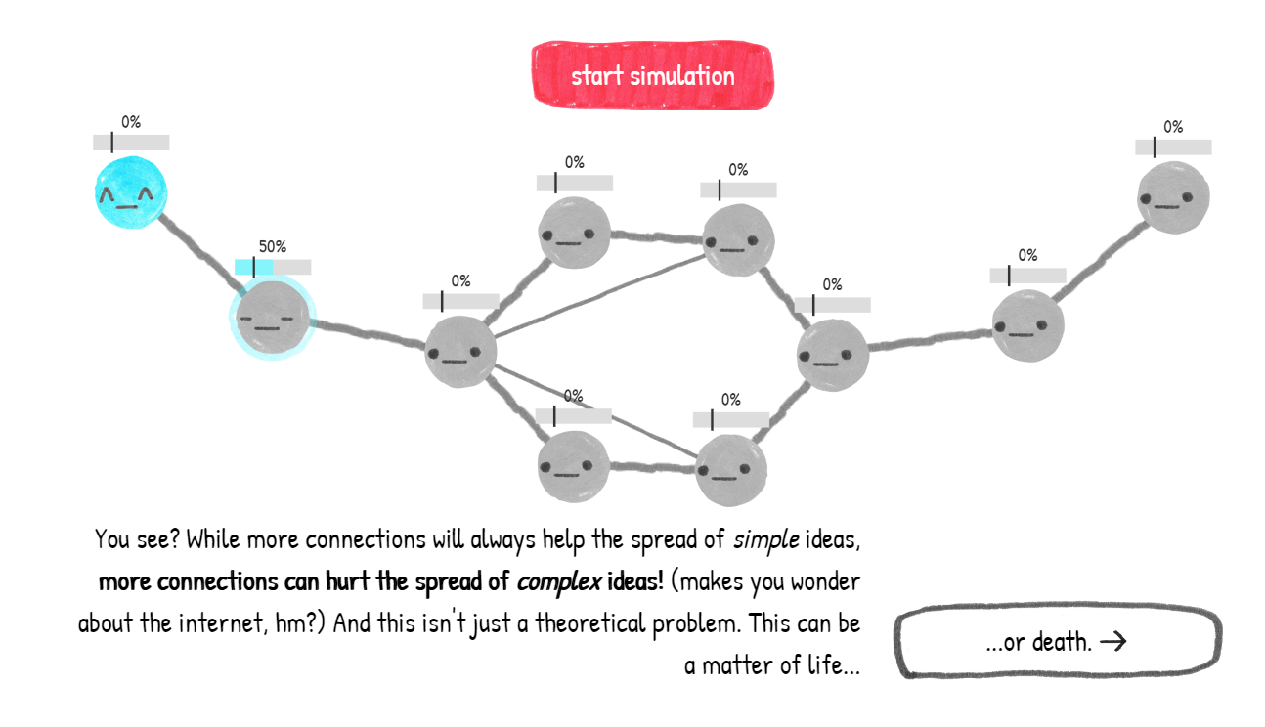
More Connections
Reference: https://ncase.me/crowds/

Slide 37
Group-Think

Slide 38
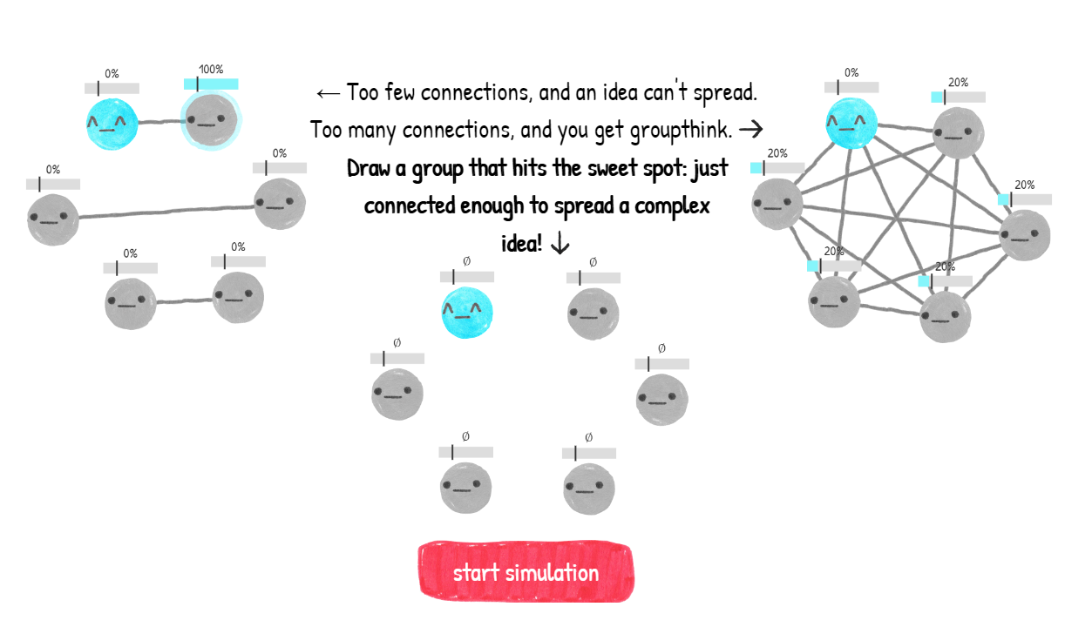
Bonding
Reference: https://ncase.me/crowds/

Slide 39
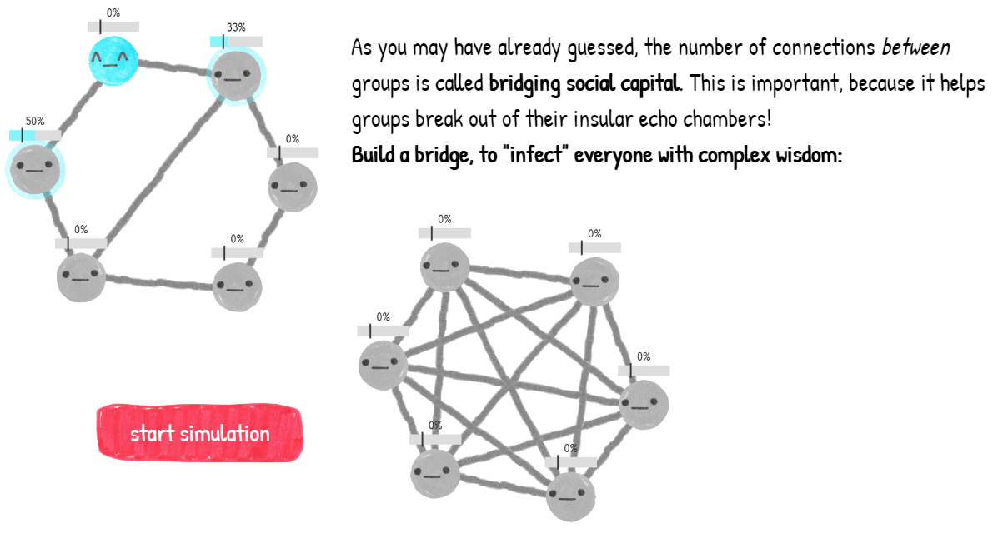
Bridging
Reference: https://ncase.me/crowds/

Slide 40
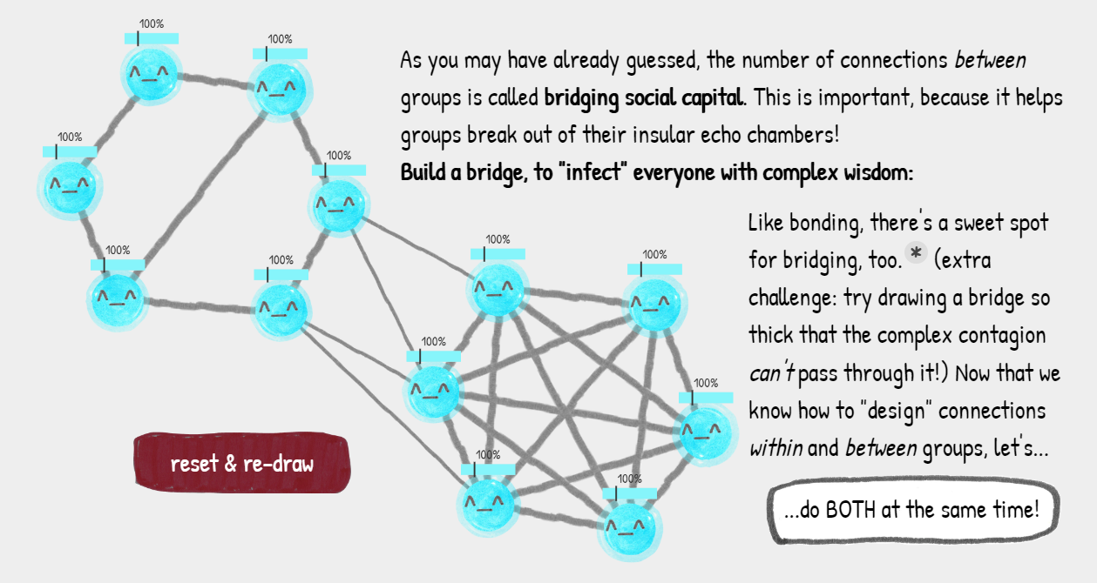
Bridging
Reference: https://ncase.me/crowds/

Slide 41
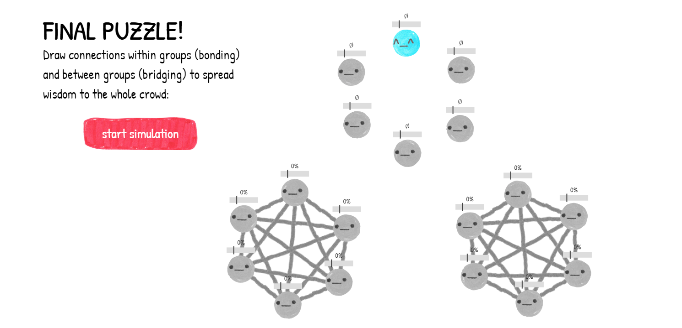
Final Puzzle Bonding and Bridging
Reference: https://ncase.me/crowds/

Slide 42
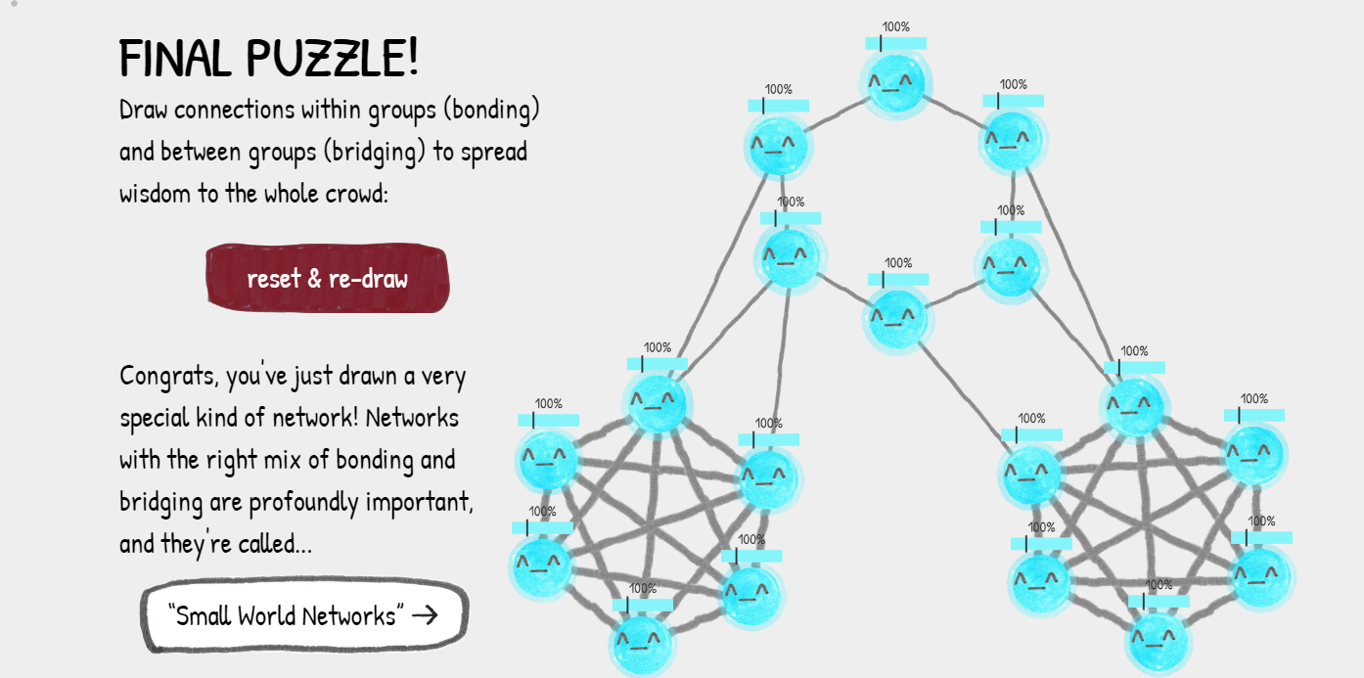
Final Puzzle Bonding and Bridging
Reference: https://ncase.me/crowds/

Slide 43
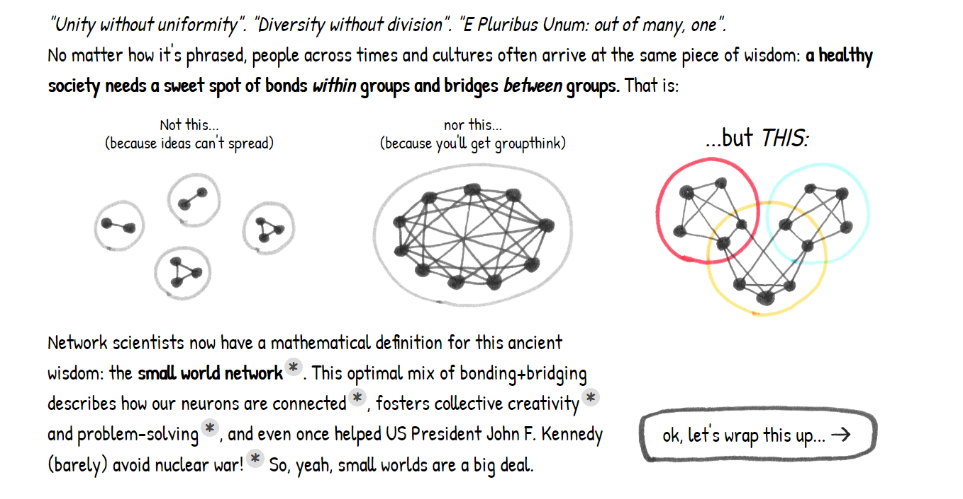
Small World Networks
Reference: https://ncase.me/crowds/

Slide 44
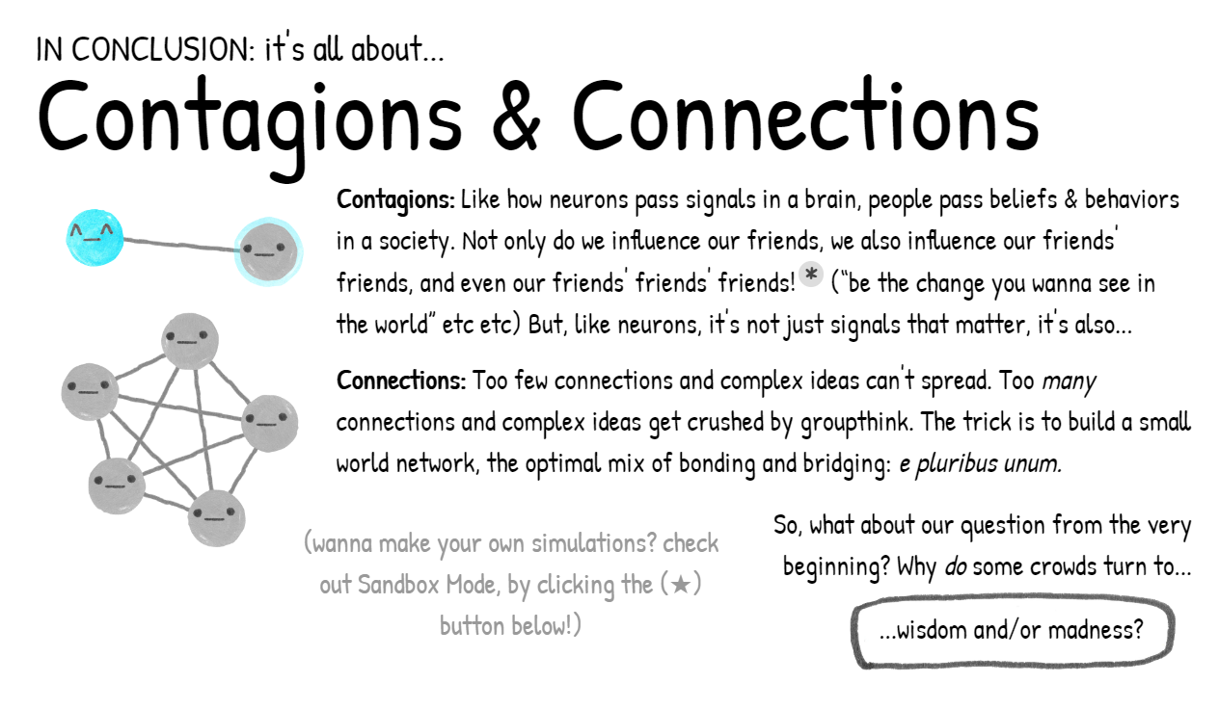
Wrapping it Up
Reference: https://ncase.me/crowds/

Slide 45
Goodbye
We hope that the information in this study material has contributed to the understanding of the most important concepts of this topic.
We invite you to continue reviewing all the educational materials available on the platform.

Slide 46
Image copyright

Slide 47
References

Slide 48
Credits
Subject Matter Expert
Instructional Designer
Jorge Alfonso Meléndez Acuña
Angela Maria Arboleda Restrepo
Subject Matter Expert
Graphic Designer
Luis Fernando Niño Vásquez
Tania Valentina Flórez Rincón
First version
Date: April 2025

